Slide 1
for your exam…
Mr. VINODKUMAR ASHOK PRADHAN
Asst. Professor, Department of English,
Sadashivrao Mandlik Mahavidyalaya, Murgud
Tal.: Kagal, Dist.: Kolhapur
pradhanvinod99@yahoo.com
9960733174

Slide 2
your study TOTOAL DAYS / TOTAL TOPICS TOTAL HOURS / TOTAL TOPICS TAKE LAST SUBJECT FIRST GO REVERSE ( IF YOU KNOW THE TIMETABLE )

Slide 3
NOTE MAKING POINTS SUBPOINTS MICROPINTS CREATE YOUR OWN SHORTFORMS, PICTURES, SYMBOLES

Slide 4
SHARE YOUR STUDY WITH YOUR FRIENDS THAN TO RECITE, DRILL HELP THEM TO UNDERSTAND

Slide 5
DON’T AVOID ANY TOPIC

Slide 6
STUDY THE TIMETABLE OF EXAM CAREFULLY DON’T READ ANYTHING BEFORE 3 HOURS OF THE PAPER

Slide 7
AT LEAST ONCE ‘I HAVE READ THIS ALL’ INCREASES YOUR CONFIDENCE

Slide 8
Keep ready PEN, PENCIL, SHARPENER, ERASER, RULER Practice spellings of days, Seat Number, Name of the Paper Number of the Paper Name of the Examination/Semester

Slide 9
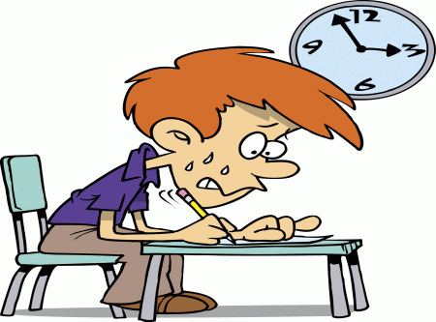
AT THE TIME OF EXAM
fill in the information on the Answer sheet without scratches and in legible handwriting
Read the question paper carefully
Solve each question (not sub-question) on a new page
Write full sentence of fill in the blank question and underline the answer chosen
Leave a blank line after each answer of question
Draw margins for:
Main question
Sub-question
Sub-sub-question
Follow the same number/roman/alphabet/capital/small

Slide 10
Obey all Exam Rules…

Slide 11
All

