Slide 1
A Presentation On Iron & SteeL By Asst. Prof. Miss.D.B.Farakte Department of Chemistry Sadashivrao Mandllik Mahavidhyalay,Murgud Tal-Kagal,Dist-Kolhapur

Slide 14
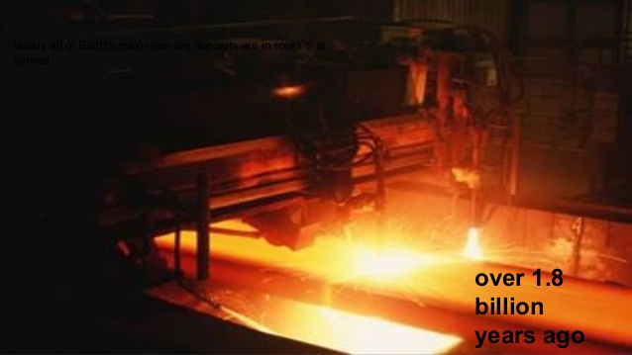

Slide 29
Thank YOU

