Slide 1
Sant Gadge Baba Amravati University, Amravati Department of Lifelong Learning and Extention in collaboration with Loknayak Bapuji Aney Mahila Mahavidyalaya, Yavatmal
POWERPOINT PRESENTATION COMPETITION
FOR PROFESSORS – 2020
An initiative to develop e-content
name of the Participant:
Mr. VINODKUMAR ASHOK PRADHAN

Slide 2
A Presentation on
B. A. Part – III English Special
Semester – V : Paper No. - VIII
By
Mr. VINODKUMAR ASHOK PRADAHN
Asst. Professor, Department of English,
Sadashivrao Mandlik Mahavidyalaya, Murgud
Tal.: Kagal, Dist.: Kolhapur
pradhanvinod99@yahoo.com 9960733174

Slide 3
Let Not Old Age Disgrace My High Desire
Was an English Poet, courtier, scholar and soldier
Prominent Elizabethan Poet
Took part in the war of Protestants against Spanish
Wounded in thigh and died of gangrene after 26 days at the early age of 31
A great human as though hiself wounded gave his water to a dying soldier saying, “Thy necessity is yet greater than mine.”
SIR PHILIP SIDNEY
(B.30 Nov. 1554 – D. 17 Oct. 1586)

Slide 4
Let Not Old Age Disgrace My High Desire
Core of the poem:
Meditation on youth and old age
An argument between youth and old age
It is defense of old age
Typical Elizabethan sonnet of 4+4+4+2=14 lines
Rhyming: abab, cdcd, efef, gg
Old age
Heavenly soul in human shape
Like dry wood giving best fire
Has white hair on face but whiteness presents respect
Wise and full of constant truth
knows whatever was in youth
Overcomes means accept and conquers youth and is bringer of honour
Youth
Disgraces old age
Produce smoke and spend virtue
Youth lacks cleanness, maturity, virtuousness
Always in haste
Foolish behaviour in youth
Unknown to the upcoming old age one day

Slide 5
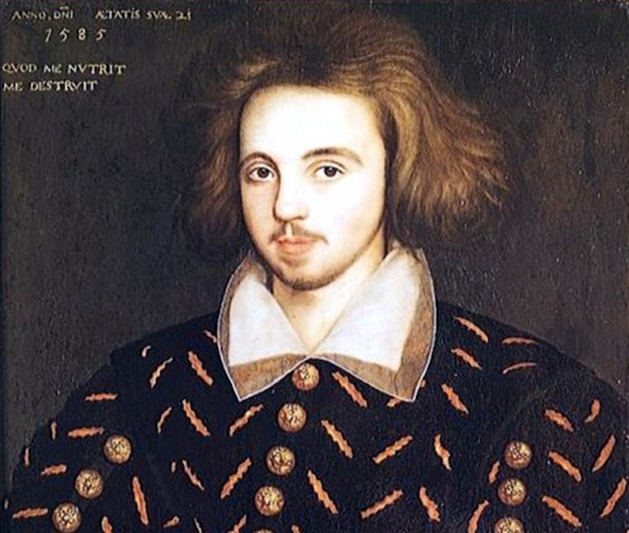
Come Live with me and be my Love (1599)
OR
The Passionate Shepherd to His Love
Was an English Poet, playwright, translator
Tragedian of Elizabethan Age
Influenced by Shakespeare
Was mysteriously stabbed to death for writing vulgar religious matter
CHRISTOPHER MARLOWE
(B. 26 Feb. 1564 – D. 30 May 1593)
Click on the speaker to listen the poem...

Slide 6
Come Live with me and be my Love (1599)
OR
The Passionate Shepherd to His Love
Core of the poem:
A well-known LOVE POEM
Nice example of PASTORAL POEM (a poem describing countryside nature)
The poem is an appeal/invitation of a lover to his beloved to enjoy pleasures of life as under:
They will wander towards valleys, groves, hills, fields
Sit upon rocks, will see shepherds feeding their flocks
The music of water in shallow rivers and lovesongs (madrigals) by birds
He will make a bed of roses and frangrant flowers for her
It will have a cap of flowers
He will offer her a gown: having embroidery of sweet-smeeling myrtle flower with its leaves – made of finest wool of a lamb
Fair lined slippers to protect from cold having pure gold buckles
The belt of straw & ivy buds with pink (coral) clasps & yellowish brown (amber) studs to it
He says if all this you like then why doesn’t she accept his love and live with him...

Slide 7
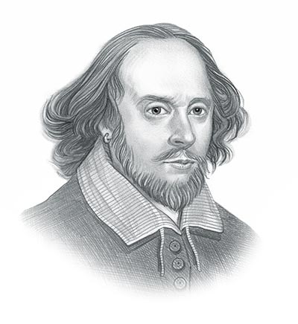
Shall I Compare thee to a Summer’s Day?
Was an English Poet, actor, playwright
Born in Stratford-upon-Avon
Was half owner of Globe theatre
Wife Anne Hathaway
Three children: Judith-daughter, Twins- Sussanna (d) and Hamnet (only son)
World’s greatest dramatist
England’s NATIONAL POET
Wrote 38 plays, 154 sonnets
Died at the age of 49 years
WILLIAM SHAKESPEARE
(B. 23 April 1564 – D. 23 April 1616)
Click on the speaker to listen the poem...

Slide 8
Shall I Compare thee to a Summer’s Day?
Core of the poem:
The poem is a compliment to a lady’s beauty
Compares beauty to a summer’s day
Summer has rough wind that shakes cute buds blooming in May, it is for a short period of time
But her beauty is lovely and temperate than summer’s day and is permanent
Sun (Eye of heaven) is hot with gold complexion also dims and other fair things also declines as weather changes season to season but her beauty will not fade
Death cannot boast before her beauty as it is eternal as long as men breathe or eyes can see

Slide 9
The Flea (1633)
was an English poet
Clergy in the Church of England
Considered the pre-eminent representative of the metaphysical poets
His works are noted for their strong, sensual style and include sonnets, love poems, religious poems, Latin translations, epigrams, elegies, songs, satires and sermons
JOHN DONNE
(B. 22 Jan. 1572– D. 31 March 1631)

Slide 10
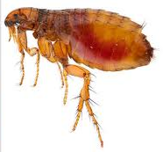
The Flea (1633)
MARK but this flea, and mark in this, How little that which thou deniest me is ; It suck’d me first, and now sucks thee, And in this flea our two bloods mingled be. Thou know’st that this cannot be said A sin, nor shame, nor loss of maidenhead ; Yet this enjoys before it woo, And pamper’d swells with one blood made of two ; And this, alas ! is more than we would do. O stay, three lives in one flea spare, Where we almost, yea, more than married are. This flea is you and I, and this Our marriage bed, and marriage temple is. Though parents grudge, and you, we’re met, And cloister’d in these living walls of jet. Though use make you apt to kill me, Let not to that self-murder added be, And sacrilege, three sins in killing three. Cruel and sudden, hast thou since Purpled thy nail in blood of innocence? Wherein could this flea guilty be, Except in that drop which it suck’d from thee? Yet thou triumph’st, and say’st that thou Find’st not thyself nor me the weaker now. ‘Tis true ; then learn how false fears be ; Just so much honour, when thou yield’st to me, Will waste, as this flea’s death took life from thee.
Click on the speaker to listen the poem...

Slide 11
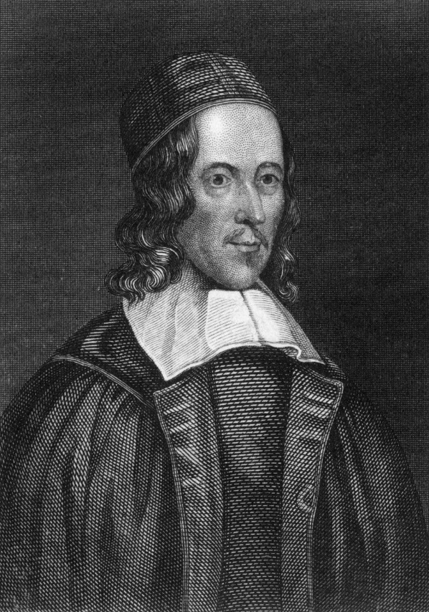
The Pulley
George Herbert was a Welsh-born poet, orator, and priest of the Church of England.
His poetry is associated with the writings of the metaphysical poets
he is recognised as "one of the foremost British devotional lyricists.“
He was born into an artistic and wealthy family and largely raised in England
Died of consumption due to serving ill people all the time
GEORGE HERBERT
(B. 3 April 1593 – D. 1 March 1633)

Slide 12
The Pulley
When God at first made man,
Having a glass of blessings standing by,
“Let us,” said he, “pour on him all we can.
Let the world’s riches, which dispersèd lie,
Contract into a span.”
So strength first made a way;
Then beauty flowed, then wisdom, honour, pleasure.
When almost all was out, God made a stay,
Perceiving that, alone of all his treasure,
Rest in the bottom lay.
“For if I should,” said he,
“Bestow this jewel also on my creature,
He would adore my gifts instead of me,
And rest in Nature, not the God of Nature;
So both should losers be.
“Yet let him keep the rest,
But keep them with repining restlessness;
Let him be rich and weary, that at least,
If goodness lead him not, yet weariness
May toss him to my breast.”
Click on the speaker to listen the poem...

Slide 13
To His Coy Mistress
Andrew Marvell was an English metaphysical poet, satirist and politician
sat in the House of Commons at various times between 1659 and 1678.
During the Commonwealth period he was a colleague and friend of John Milton
ANDREW MARVELL
(B. 31 March 1621 – D. 16 Aug. 1678)

Slide 14
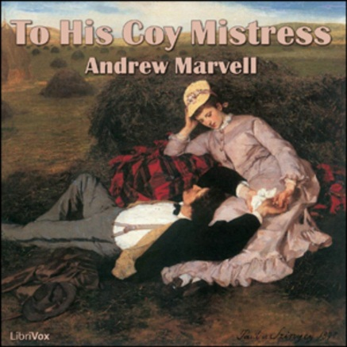
To His Coy Mistress
Had we but world enough, and time, This coyness, Lady, were no crime. We would sit down and think which way To walk and pass our long love's day. Thou by the Indian Ganges' side Shouldst rubies find: I by the tide Of Humber would complain. I would Love you ten years before the Flood, And you should, if you please, refuse Till the conversion of the Jews. My vegetable love should grow Vaster than empires, and more slow; An hundred years should go to praise Thine eyes and on thy forehead gaze; Two hundred to adore each breast; But thirty thousand to the rest; An age at least to every part, And the last age should show your heart; For, Lady, you deserve this state, Nor would I love at lower rate. But at my back I always hear Time's wingèd chariot hurrying near; And yonder all before us lie Deserts of vast eternity. Thy beauty shall no more be found;
Nor, in thy marble vault, shall sound
My echoing song; then worms shall try
That long-preserved virginity,
And yoiur quaint honour turn to dust,
And into ashes all my lust;
The grave’s a fine and private place,
But none, I think, do there embrace.
Now therefore, while the youthful hue
Sits on thy skin like morning dew,
And while thy willing soul transpires
At every pore with instant fires,
Now let us sport us while we may,
And now, like amorous birds of prey,
Rather at once our time devour
Than languish in his slow-chapped power.
Let us roll all our strength and all
Our sweetness up into one ball,
And tear our pleasures with rough strife
Through the iron gates of life:
Thus, though we cannot make our sun
Stand still, yet we will make him run.
Click on the speaker to listen the poem...

Slide 15
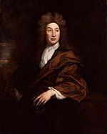
Song to a Fair Young Lady
was an English poet, literary critic, translator, and playwright
was made England's first Poet Laureate in 1668.
He is seen as dominating the literary life of Restoration England to such a point that the period came to be known in literary circles as the Age of Dryden.
JOHN DRYDEN
(B. 9 Aug. 1631– D. 12 May 1700)

Slide 16
Song to a Fair Young Lady
Ask not the cause why sullen spring
So long delays her flow’rs to bear;
Why warbling birds forget to sing,
And winter storms invert the year?
Chloris is gone; and Fate provides
To make it spring where she resides.
Chloris is gone, the cruel fair;
She cast not back a pitying eye:
But left her lover in despair,
To sigh, to languish, and to die:
Ah, how can those fair eyes endure
To give the wounds they will not cure!
Great god of Love, why hast thou made
A face that can all hearts command,
That all religions can invade,
And change the laws of ev’ry land?
Where thou hadst plac’d such pow’r before,
Thou shouldst have made her mercy more.
When Chloris to the temple comes,
Adoring crowds before her fall;
She can restore the dead from tombs,
And ev’ry life but mine recall.
I only am by love design’d
To be the victim for mankind.
Click on the speaker to listen the poem...

Slide 17
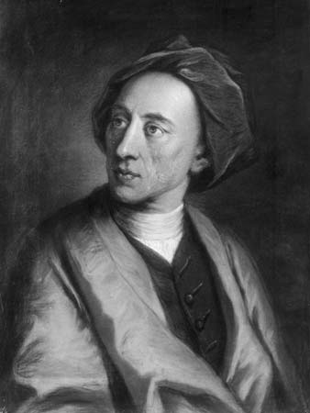
To Mrs. M. B. on her Birthday
born on 21st May 1688 in London in Roman Catholic family.
was the son of a wealthy tradesman.
was a sick and delicate child.
He was denied the privilege of education and a first class school.
But was a studious child and started reading at home.
possess remarkably correctness in writing words before he was 16 years old.
poetry mainly satirical.
ALEXANDER POEPE
(B. 21 May 1688– D. 30 May 1744)

Slide 18
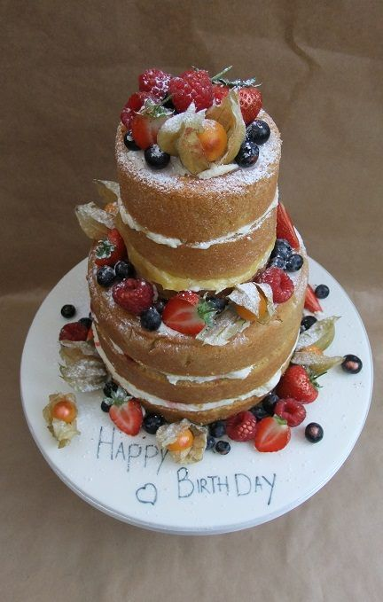
To Mrs. M. B. on her Birthday
Oh be thou blest with all that Heav’n can send, Long Health, long Youth, long Pleasure, and a Friend, Not with those Toys the female world admire, Riches that vex, and Vanities that tire. With added years if Life bring nothing new, But, like a Sieve, let ev’ry blessing thro’, Some joy still lost, as each vain year runs o’er, And all we gain, some sad Reflection more; Is that a Birth-Day? ’tis alas! too clear, ‘Tis but the funeral of the former year. Let Joy or Ease, let Affluence or Content, And the gay Conscience of a life well spent, Calm ev’ry thought, inspirit ev’ry grace. Glow in thy heart, and smile upon thy face. Let day improve on day, and year on year, Without a Pain, a Trouble, or a Fear; Till Death unfelt that tender frame destroy, In some soft Dream, or Extasy of joy, Peaceful sleep out the Sabbath of the Tomb, And wake to Raptures in a Life to come.
Click on the speaker to listen the poem...

Slide 19
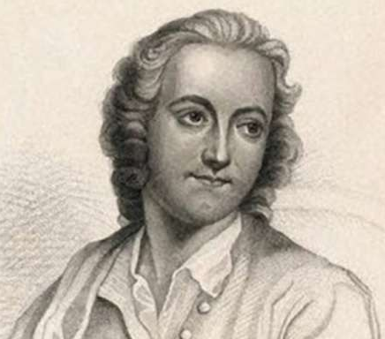
Elegy Written in a Country Churchyard (1751)
was born on 26 December 1716 in London.
was educated at Eton and Cambridge.
was offered the Laureateship in 1757 but refused.
In 1768 was appointed as professor of History at Cambridge.
died on 30 July 1771 of illness and was burried at Stoke Pogis in Bucks the place which inspired him to this poem
This poem is his meditation on a typical English churchyard with mounds, gravestones and yew trees
This poem is a reflection of poet on the lives of the simple and poor people.
THOMAS GRAY
(B. 26 Dec. 1716– D. 30 July 1771)
Click on the speaker to listen the poem...

Slide 20
Poison Tree
was born on 28th November 1757 in London.
was the son of hosier who showed a remarkable understanding of his son's mental setup and gave him training in painting, sculpture and engraving
earned his livelihood by working as an engraver.
Without much formal education had great spiritual learning.
‘Songs of Innocence’, ‘This Book of Them’, ‘Songs of Experience’, ‘Marriage of Heaven and Hell’ are major literary works
WILLIAM BLAKE
(B. 28 Nov. 1757– D. 12 Aug. 1827)

Slide 21
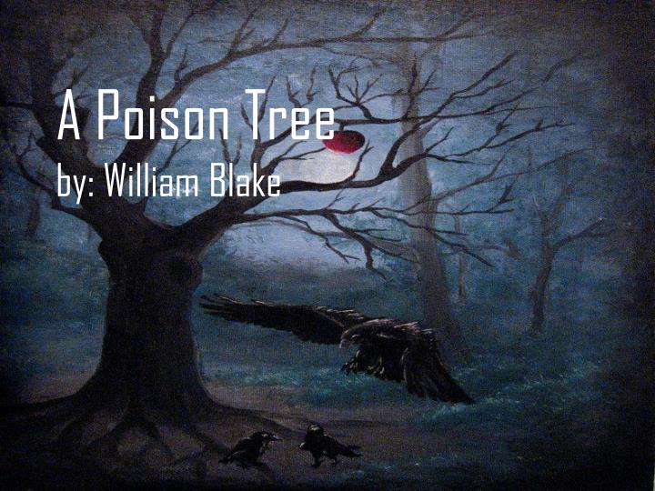
Poison Tree (1794)
from ‘Songs of Experience’
I was angry with my friend: I told my wrath, my wrath did end. I was angry with my foe: I told it not, my wrath did grow.
And I watered it in fears. Night and morning with my tears: And I sunned it with smiles. And with soft deceitful wiles.
And it grew both day and night. Till it bore an apple bright. And my foe beheld it shine. And he knew that it was mine.
And into my garden stole. When the night had veild the pole; In the morning glad I see; My foe outstretchd beneath the tree.
Click on the speaker to listen the poem...

